Slide 1
Process & Troubleshooting Guidelines
Hanwha Azdel

Slide 2
Table of Contents
Process Section
General Processing & Forming Characteristics Slide 6-8
Adhesive Bonding Slide 9
Typical Azdel Manufacturing Cell Slide 10
Product Loading & Conveying
Pick and Place Slide 12-13
Static Electricity Slide 14-17
Pick and Place Pallet Cart Slide 18-19
Pin Chain/Clamping Slide 20
Product Heating
Considerations Slide 22
Equipment Slide 23-26
Key Temperatures Slide 27
Variability Slide 28
Color Influences Slide 29
Product Expansion Slide 30-31
Sheet Sag Slide 32

Slide 3
Table of Contents
Process Section
Product Forming
Tensioning Slide 34
Tooling Slide 35
Press Slide 36
Molded Thickness Slide 37-38
Product Trimming & Cutting
Methods Slide 39-40
Water-Jet Factors Slide 41
Dimensional Stability Slide 42
Edge Folding Slide 43-44

Slide 4
Table of Contents
Troubleshooting Section
Preliminary Troubleshooting Slide 46-47
General Troubleshooting Guidelines Slide 48
Troubleshooting Suggestions Slide 49-51
Specific Troubleshooting
Loft-Related Considerations Slide 52-53
Wrinkles Slide 54-55
Scrim Tearing Slide 56
Scrim Delamination Slide 57
Fabric Delamination Slide 58-59
Warp or Deformation Slide 60

Slide 5
Process Section

Slide 6
General Processing & Forming Characteristics
The process is characterized as “Thermo-stamping” or “Matched-mold Thermoforming”.
• The material is supplied in a rigid form and must be made pliable or “drape-able” through preheating. Preheating also allows the material to expand or “loft” to the desired thickness for forming/shaping into the desired geometry.
• Typical forming pressures are low and rarely exceed atmospheric pressure.
• The material is typically covered with an in-mold appliqué (typically fabric) to achieve a desired appearance. This, along with mold geometry and other in-mold attachments, will influence the forming behavior of the Azdel material and the resulting molded part.
• For optimal section stiffness, lofted material should not be fully compressed during molding.
• Formed thickness from fully heated/lofted material can be variable within a single part. It is influenced both by the spacing of the two forming mold halves when in a “closed” tool position and by the extension of the material that occurs as the heated sheet is drawn into the desired part geometry. In most cases, smaller mold gaps and larger material extensions result in a thinner molded section.

Slide 7
General Processing & Forming Characteristics
• Double-platen pressure forming equipment is ideal for forming Azdel material. However, traditional compression molding presses with stand-alone ovens and product transfer implements can also be used.
• Typical forming pressures are around 1-2 bar (15-30 psi) and are unlikely to exceed 5 bar (75 psi).

Slide 8
General Processing & Forming Characteristics
Sheet heating, transport, clamping and forming pressure are the most important processing factors for Azdel products. Key considerations are as follows:
Ovens equipped with infra-red heating elements (ceramic or quartz) are most common.
Independently controllable heating zones for local sheet area temperature adjustment
are recommended.
Additional ovens can be used to increase throughput and reduce cycle time.
Heating times will vary according to oven design and grade. Typical single-
oven heating time is 25-100 seconds, depending on zone temperature setpoints and
material grade:
  Product weights from 600 to 1200 GSM: ~ 25-50 seconds
  Product weights from 1400 to 2000 GSM: ~ 50-100 seconds
• Preheat temperature: ~ 400˚F-420˚F (204˚C-215˚C).
Mold close sheet temp: ~ 380˚F-390˚F (193˚C-199˚C).
• In-process transfer: 4-sided frame, 2-sided rail, or metal-mesh conyeyor.
• Maximum transfer/“open” time (oven exit to mold close): 10-15 seconds.
• Tool temperature: typical mold temperature is 70˚F (21˚C) up to 120˚F (49˚C). 80˚F is
the most typical.
• Sheet clamping and tension: 4-sided and adjustable
• Residence (dwell) time for pressing : ~ 20-50 seconds

Slide 9
Adhesive Bonding
Azdel material is thermoplastic-based, but the composition of films and scrims used in combination will affect the choice of adhesive. The use of different types of adhesives is highly dependent upon the substrates being bonded. Therefore, please refer to an adhesive supplier for recommendations of appropriate products. Some examples are displayed below.
Bostik
Automotive & Industrial Div.
211 Boston Street
Middleton, MA 01949
Tel: (888) 333 6630
Fax: (978) 750-7319
URL: www.bostik.com
3M
Bonding Systems Division
3M Center, Bldg. 220-7E-01
St. Paul, MN 55144-1000
Tel: (800) 362-3550
URL: www.3M.com
Loctite Corporation
1001 Trout Brook Crossing
Rocky Hill, CT 06067
Tel: (860) 571-5100
Fax: (860) 571-5465
URL: www.loctite.com

Slide 10
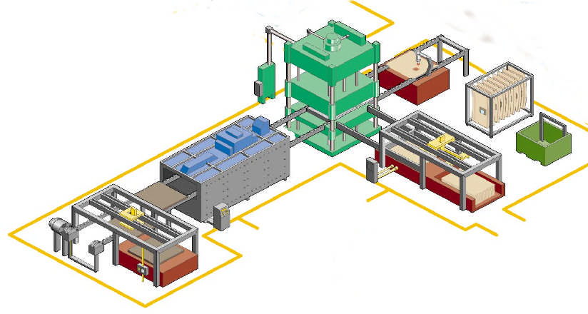
Typical Azdel Manufacturing Cell
Forming press
Trim station
Heating oven
Clamped SuperLite
Indexing conveyor
Fabric shuttle system
Fabric
Pallet of SuperLite

Slide 11
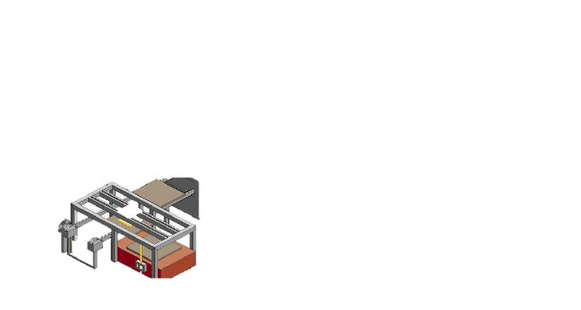
Product Loading & Conveying
Clamped SuperLite
Indexing conveyor
Pallet of SuperLite

Slide 12
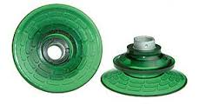
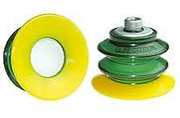
Pick and Place
Capture Types
Vacuum pick-up systems – good range of motion but sensitive to season static “sticking” and sheet permeability.
Needle grippers – better for permeable sheet.
Combo – best system. Sequenced vacuum used to help eliminate static-induced sheet sticking and needle grippers to eliminate permeability issues.
Vacuum
The quantity of suction cups and grippers are dependent on sheet construction, size, and air permeability. Since most Azdel material has some air permeability, a trial-and-error approach may be needed. A recommended starting point is 12 suction cups and 8 needle grippers.
There are multiple cups available including single bellow (below left) and double below (below right). Double bellow is recommended because of its enhanced grip on the sheet surface and reduced risk of grip failure.

Slide 13
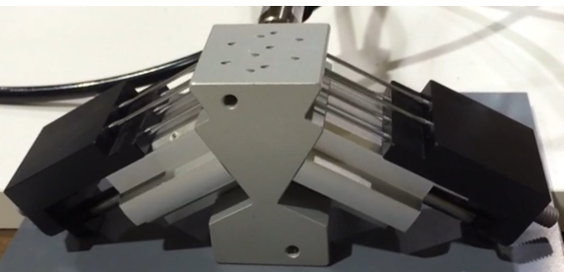
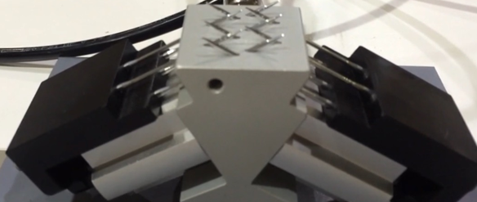
Pick and Place (cont.)
Needle grippers
Needle grippers are pneumatically-activated sharp-tip pins that penetrate the Azdel material at an angle from above the sheet. The illustrations below show the pin blocks in both the non-activated and activated modes. These have the advantage of not being susceptible to sheet air permeability.
Gripper pins not activated
Gripper pins activated
As stated previously, capture systems that use both suction and needle methods (Combo systems) are the most effective and reliable.

Slide 14
Static Electricity
Static electricity is a condition that is unavoidable and can sometimes cause two or more boards to stick together during lifting/conveying. There are a number of measures to either reduce the static charge or defeat the sticking effect.
Static discharging brushes
Static brushes are often made from metal bristles held together with a metal channel. They are made to discharge electricity created by static through a grounding wire. The left-side image on the next page is one example of a static discharging brush. It is manufactured by Precision Brush Company Inc. There are many other companies that make this type of brush.
Friction resistance brushes
These brushes are made of synthetic bristles that are stiff and wider than a static discharge brush. They work by causing resistance (“dragging”) to the sheets being picked up that is stronger than the static charge. This causes the unwanted extra sheet(s) to fall away back onto the sheet stack. A common brush that is used for this purpose is the end of a push broom like one displayed on the right side of the next page.
*See next page for examples*

Slide 15
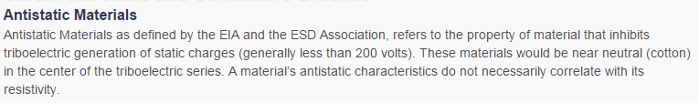
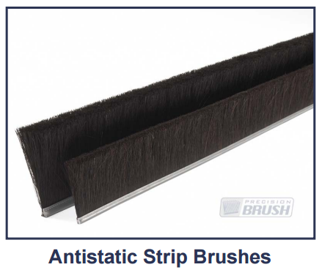
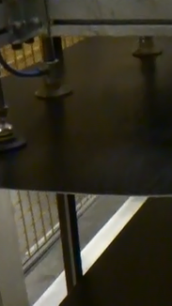
Static Electricity (cont.)
Friction resistance brushes

Slide 16
Static Electricity (cont.)
Static Electricity Management Air Solutions
Ionizer Fan
Industrial ionizer fans work by blowing positively-charged ions into the air to neutralize the negative charges that are characteristic of the static. They can be mounted on the floor or the wall.
Air Curtain or Knife
An air curtain works by forcing ion-charged air flow between the sheet being picked up and the rest of the stack. For an air curtain or knife to be successful it needs to be aimed just under the sheet that is being picked up. The charged air stream can then separate the desired top sheet from the undesired additional sheet(s). A description of how an air knife functions follows on the next page.
*See next page for examples*

Slide 17
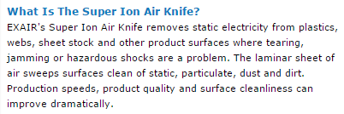
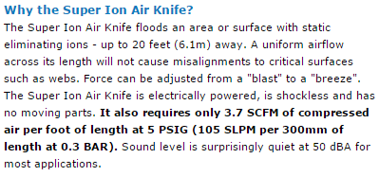
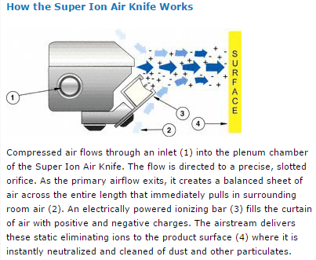
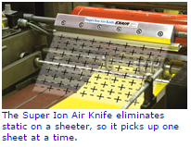
Static Electricity (cont.)

Slide 18
Pick and Place Pallet Cart
Pick and Place Cart
[The following two pages are an example of upgrades to prevent boards sticking together.]
The upgrades to this pallet cart made the new system much more robust than the temporary system it replaced. It has increased static grounding exposure, eliminated the potential for snagging board edges, and created two sources of board edge resistance to overcome sticking.
The pneumatic guide system has a dual benefit: it increases resistance at the board edge (which helps overcome sticking of 2 or more boards) and prevents misalignment of the occasional 2nd board that falls back on the stack after being lifted away. (The old system was constructed such that when the pallet stack was low, the “fall-away” board could get caught under the stack bracket.) The new system is self-adjusting in the “X” (width) direction and is manually adjustable in the “Y” (length) direction. It is engineered so there is no longer a snag point in the “Z” (height) direction; the edge guides are now continuous down past the bottom board. Also included is a longer permanently-affixed brush to bolster the board separation process. This system also allows for the boards, if stuck together, to align with the boards below.
The upgraded static grounding system has 50% more board edge exposure, but the effectiveness of both the old and new were/are minimal. Even with the new measures in place, there was still occasional between-board static arcing that was occurring with board separation of 12-15” above the pallet stack. It may require an ionic blower or some other active measures to gain any significant advantage over static.
*See next page for illustrations*

Slide 19
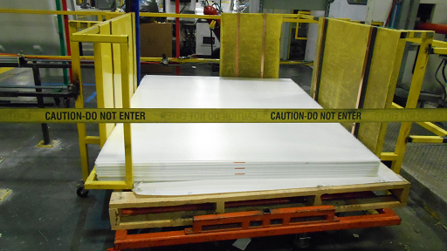
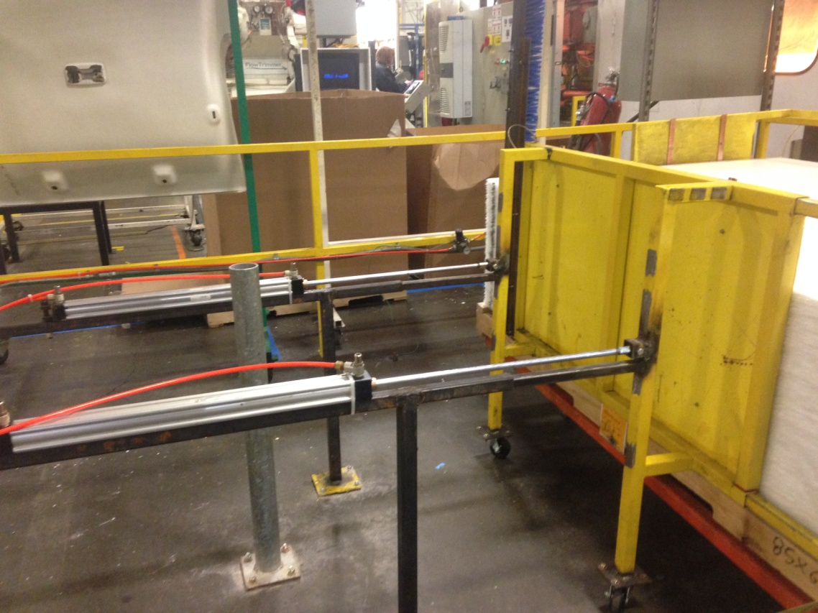
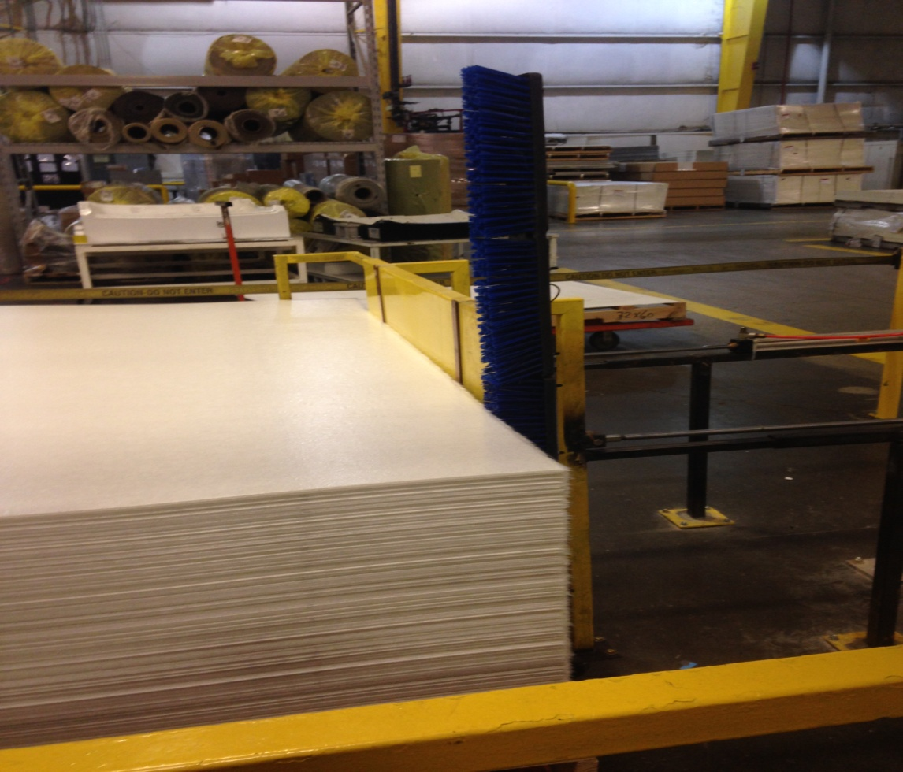
Pick and Place Pallet Cart (cont.)
Pneumatically-deployed guidance and board edge resistance system.
Grounding straps on 3 of the 4 edges.
Board edge brush for resistance

Slide 20
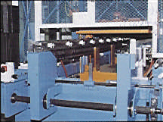

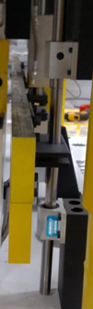
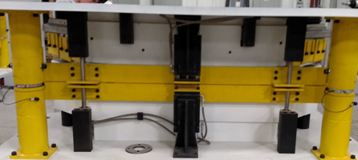
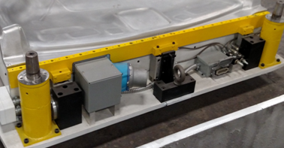
Pin Chain/Clamping
Function
To hold the Azdel sheet in place during heating and forming cycles.
Azdel
General characteristics
4-sided clamping in a pneumatically- operated clamp frame is preferred.
Fully automated in-line systems using pin chains to hold sheet during transfer are most common.
Tension blades (clamps on the tool sides perpendicular to the chain rails) are recommended to apply 4-sided sheet tension during forming.
If compression molding equipment is being used, a separate “pin” frame (tenter frame) on a conveyor belt can be used to transport the sheet, but this method is not preferred.
Pin frame
Typical pin chain rail
Typical front and rear clamping

Slide 21
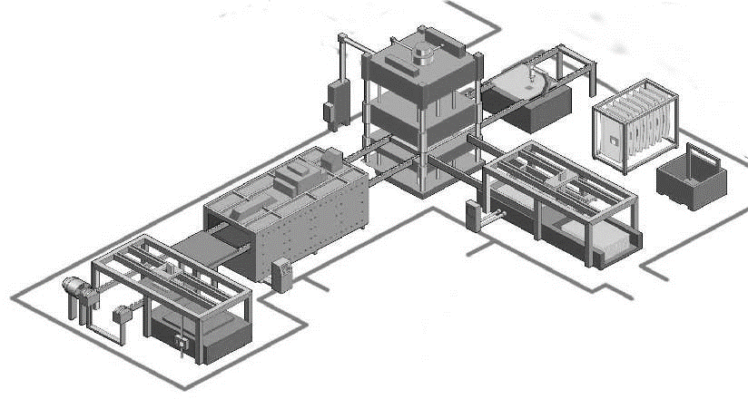
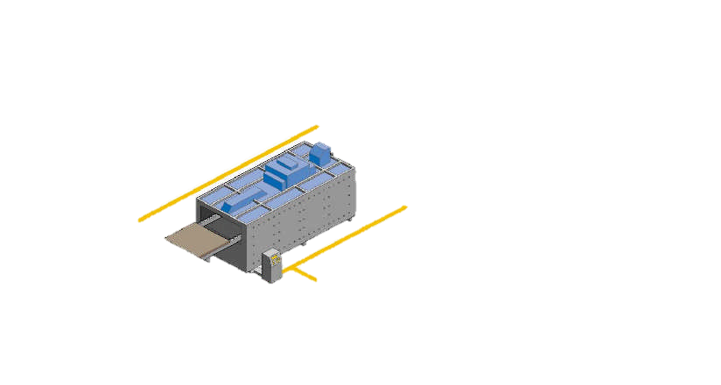
Product Heating
Heating oven

Slide 22
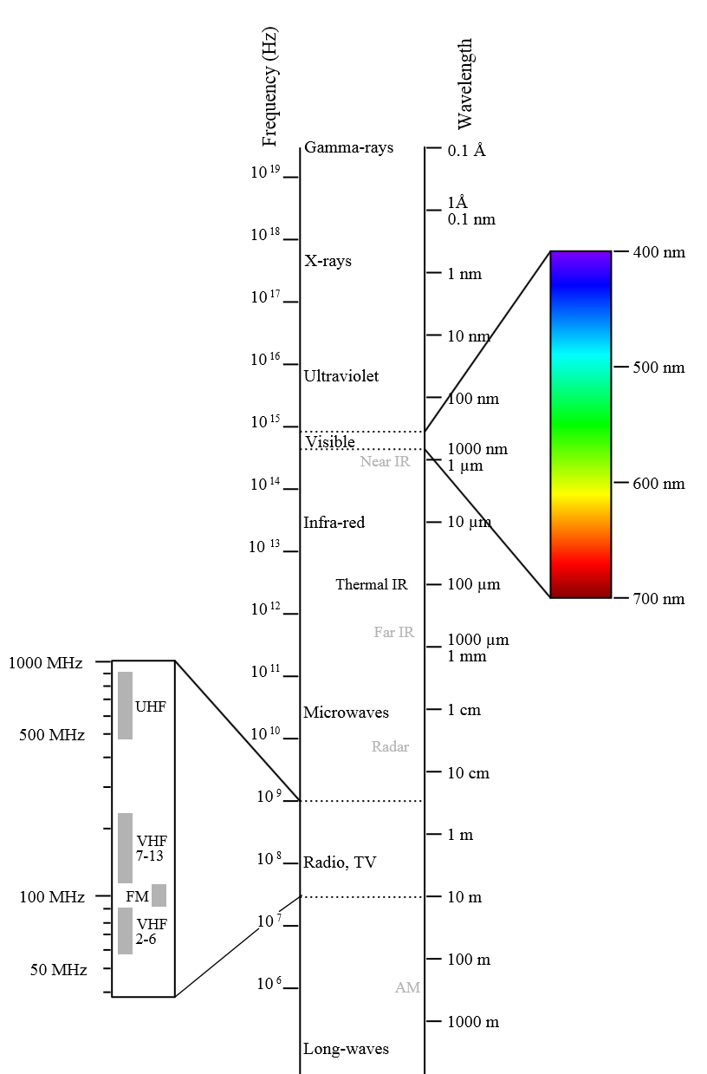
Product Heating - Considerations
Function
To make the Azdel sheet pliable or “drape-able” so that it can be molded into the desired geometry.
Key Considerations
• Heat Transfer Methods
  o Conduction (contact)
  o Convection (forced air)
  o Radiation (element or bulb)
Types of Radiant heat
  o Ultra Violet
  o Microwave
  o Radio Frequency / Induction
  o Infrared
Material Transport System
  o 4 sided frame
  o 2 sided rail
  o Belt
  o Hybrid System
The IR spectrum (0.72μ - 1000μ)
• Near IR (short wave) = 0.72μ-1.5μ
• Middle IR (medium wave) = 1.5μ - 5.6μ
• Far IR (long wave) = 5.6μ – 1000μ

Slide 23
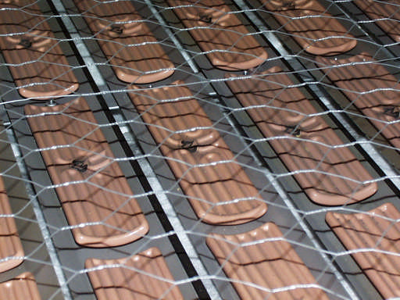
Product Heating - Equipment
Infrared ovens typically use
medium infra-red wavelength.
Medium infra-red wavelength is
from 3.0 to 4.0 υm.
Generally, as the wavelength
decreases the radiated power
increases.
A crossover into the
medium/long wavelength
spectrum is permitted.
Typical ceramic IR elements

Slide 24
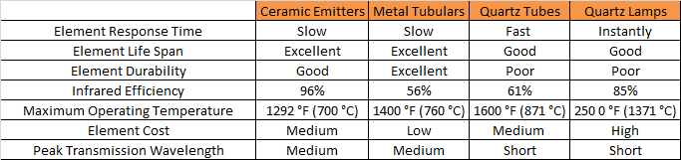
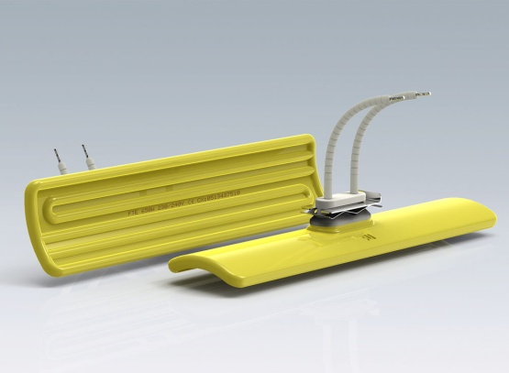
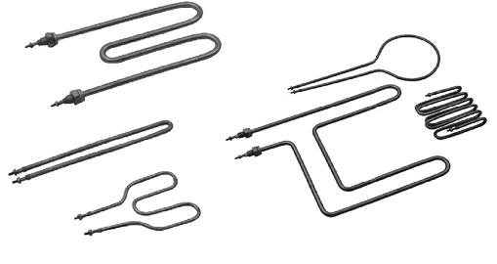
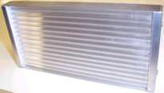
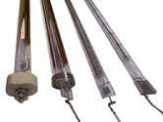
Product Heating - Equipment (cont.)
Power Density
Dependent on the final oven selection, a target of 15-25 watts/in² or 2.3-3.9 watts/cm²
Element Spacing
Elements spacing should be based on recommendation by oven and/or element manufacture with consideration of and additional spacing for Azdel heated sheet sag (see sheet sag reference page).
Index Trigger
Time, temperature and sheet sag
Combining of all 3 is a best practice with target temperature as the leading index trigger & complimentary “fail-safe” index triggers for max time & max sheet.

Slide 25
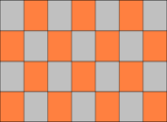
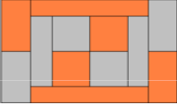
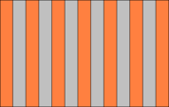
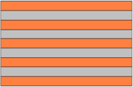
Product Heating - Equipment (cont.)
A minimum of one (1) IR sensor or radiometer per oven, per
sheet surface should be used to control and/or monitor the
actual sheet surface temperature as influenced by the
oven’s process.
Use of a thermal imaging line scanner or similar device has
been recognized as a best practice for identifying and
correcting overall sheet temperature variability.
A minimum of 1 should be installed at the exit side of the oven.
The exit side of the oven should include the appropriate
mounting accommodations to allow a change to evaluation
surface (top/bottom) if only one thermal imaging device is
installed.
Oven Zoning – Key Considerations
Number of zones
Layout of zones
Element Wavelength
Element power density
Zoning Examples
Most adjustable
Sufficient Adjustability
Not ideal
(risk of heat loss at edges)

Slide 26
Product Heating - Equipment (cont.)
Oven zones
The lower oven zones (elements) should be shielded with suspended support wires, IR permeable mesh or a comparable safeguard. This will provide protection from contact between the oven elements and the heated material. protection from damage (fire, etc) that could possibly occur via an overheated material condition or exposure to other flammable sources (debris, contaminants, etc).
Oven Enclosure
A fully enclosed oven with actuated doors for open and close action is preferred.
External Environment
Ambient temperature and humidity can have a large impact on process repeatability. If the environment is not controlled, the ambient plant temperature and humidity should be tracked and recorded to assist in anticipating process adjustments.

Slide 27
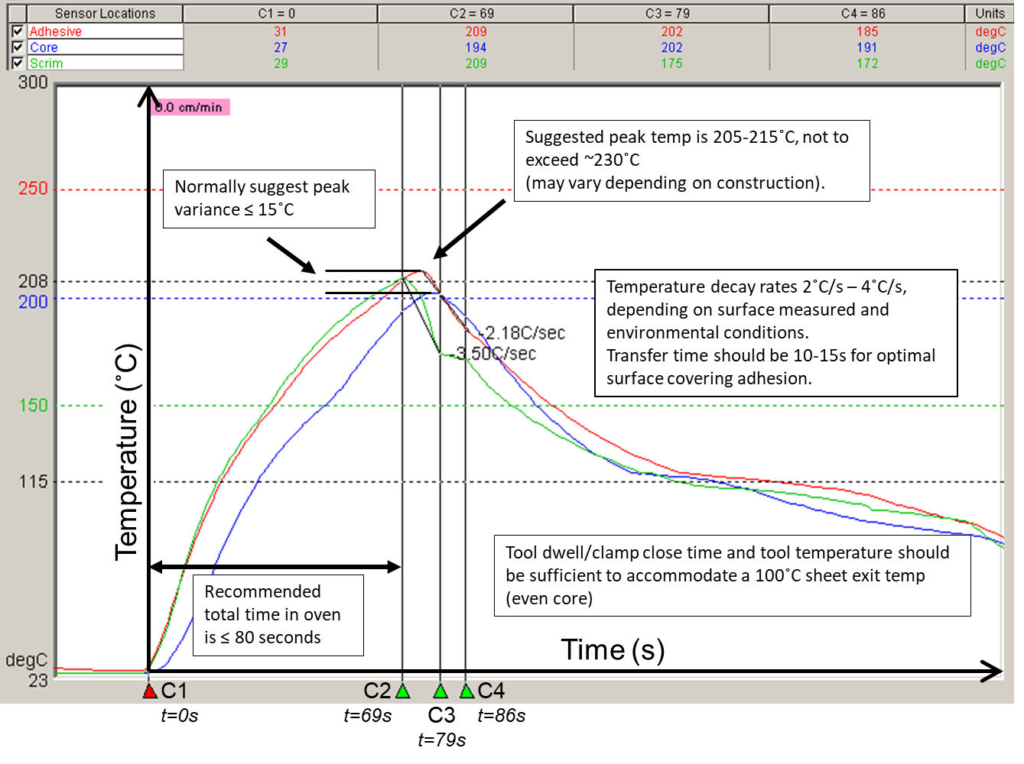
Product Heating – Key Temperatures

Slide 28
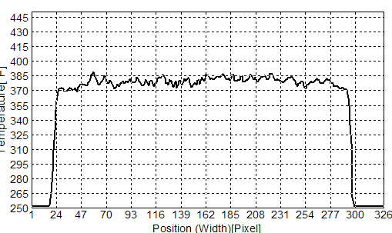
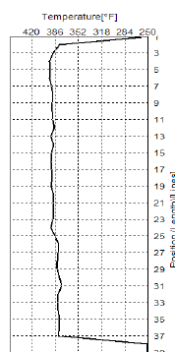
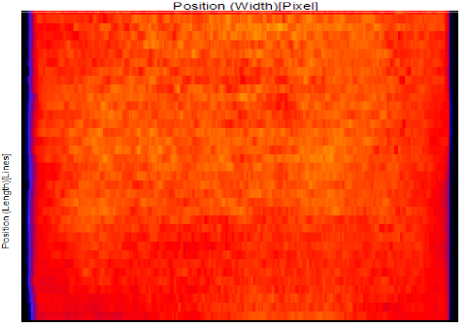
Product Heating – Variability
Within-sheet variability (across surface and through thickness) should be ≤ 20°C.

Slide 29
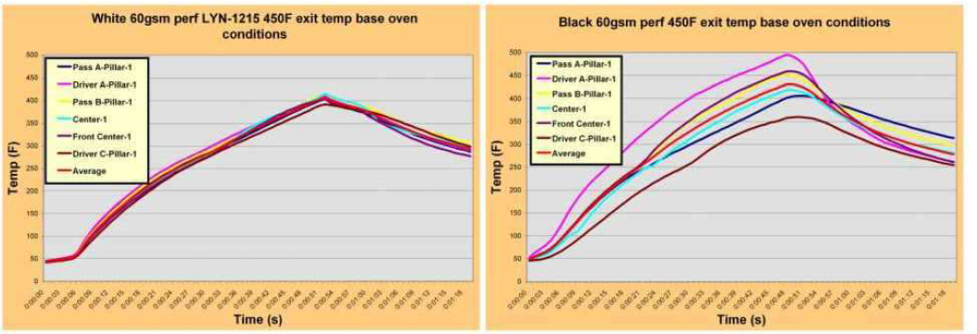
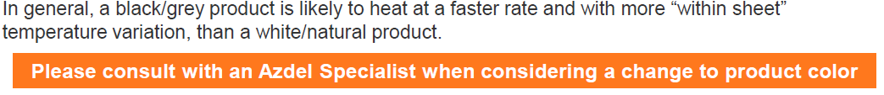
Product Heating – Color Influences
Azdel material is available in 2 basic color types (black/gray and natural/white). Historic data indicates that these two colors have different IR absorption characteristics and may require a different oven recipes to achieve the same temperature result. The difference is dependent on the peak operating wavelength of the emitter type.
Medium-to-short wavelength emitters require little adjustment when changing between product
colors while long-to-medium wavelength emitters are affected to a greater degree and typically
require more substantial modifications to the oven recipe.

Slide 30
Product Heating – Product Expansion
When the product is heated properly, it will loft to its maximum thickness.
The expected trends for product loft are as follows:
  Higher weight products loft more than lower weight products
  Longer exposures to elevated temperatures result in higher loft
  XLT and XtraLite products loft more than standard SuperLite

Slide 31
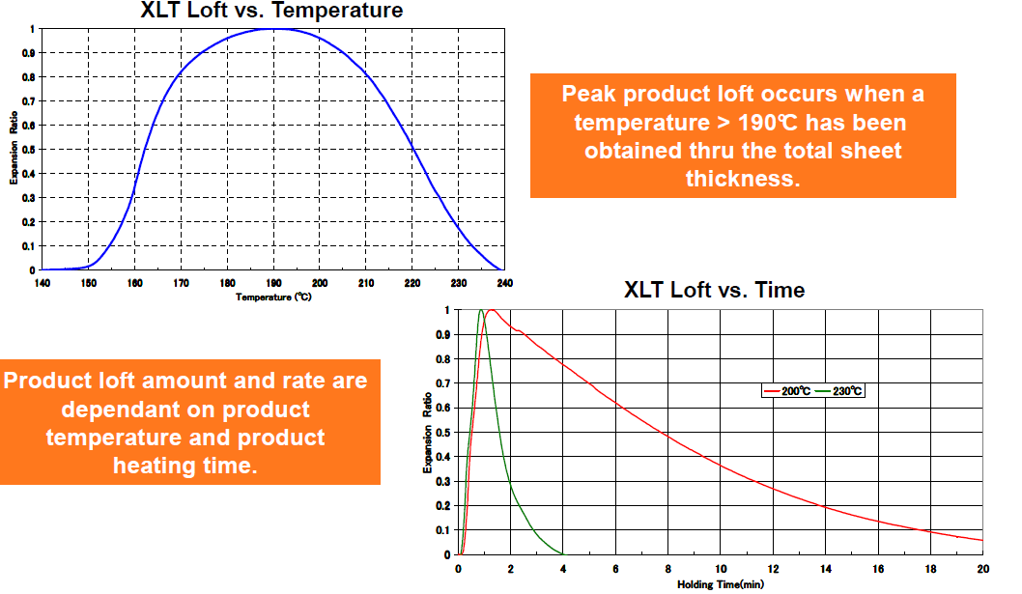
Product Heating – Product Expansion (Cont.)
Trends for product heating time, rate and subsequent product temperatures are illustrated below. XLT is more sensitive to these parameters than standard SuperLite.

Slide 32
Product Heating – Sheet Sag
Additional dimensional change is expected during the heating of a SuperLite sheet. The center point of the sheet will drop or “sag” below the edges of the sheet.
Although expected, it is important that this dimensional change be verified and controlled.
  Too much sag can indicate an overheating condition and/or lead to molded material folds, creases, etc.
  Too little sag can indicate an under-heating condition and lead to tears, blow-outs, creases and poor inter-laminar strength.
Key factors for sag include product grade, product temperature and clamping.
Additional control can be established via.
  Running with 4 sided clamping of the sheet vs. 2 sided clamping has been proven to reduce sag
  Running lower temperature on the scrim side can reduce the amount of sag.
  When utilizing a two sided pin-chain system, set-up a V or run-out that will continually stretch the Azdel as it indexes thru the oven and into the forming area
  A clamping mechanism that has the ability to stretch / pull out sag prior to molding is beneficial.

Slide 33
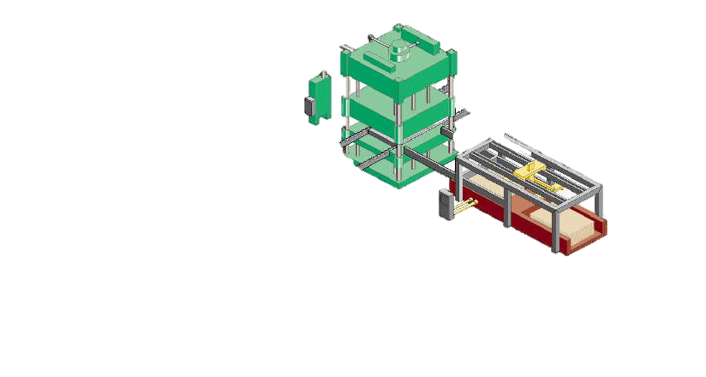
Product Forming & Trimming
Forming press
Fabric

Slide 34
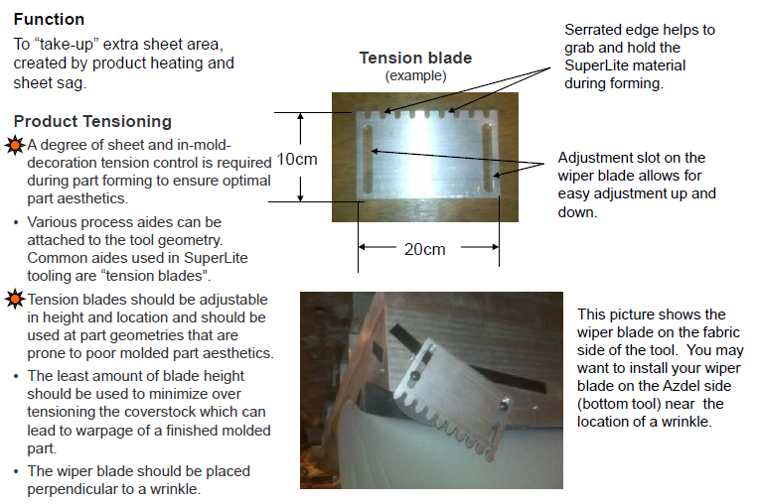
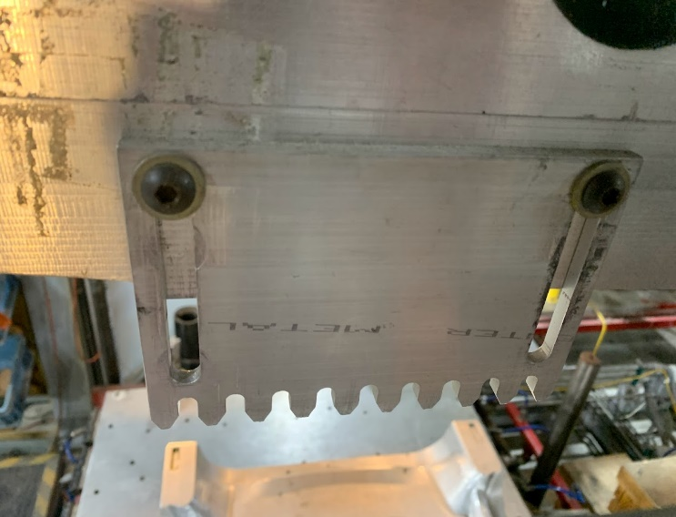
Product Forming – Tensioning

Slide 35
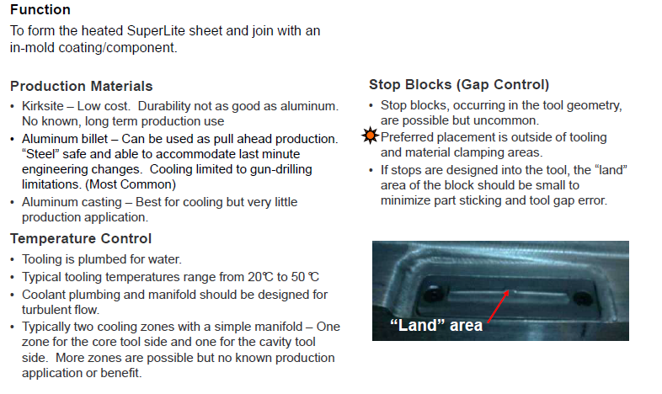
Product Forming – Tooling

Slide 36
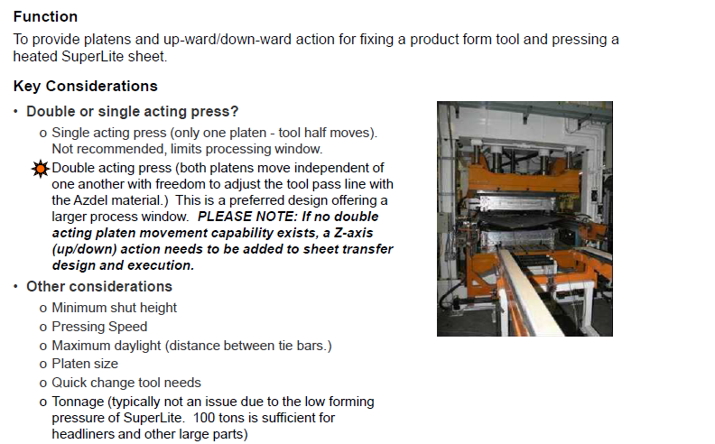
Product Forming – Press

Slide 37
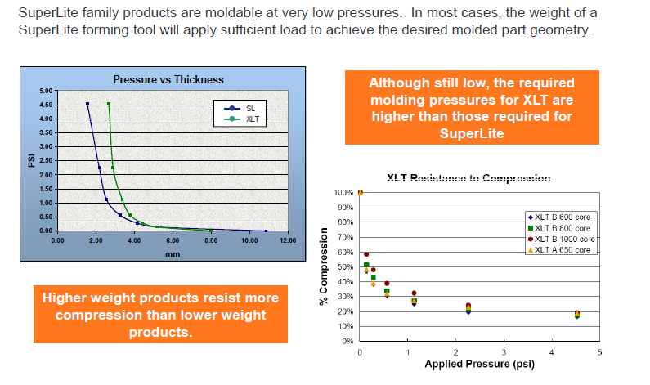
Product Forming – Molded Thickness

Slide 38
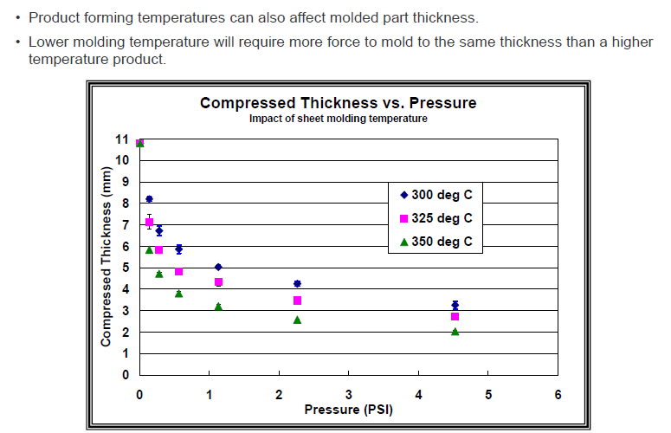
Product Forming – Molded Thickness (cont.)

Slide 39
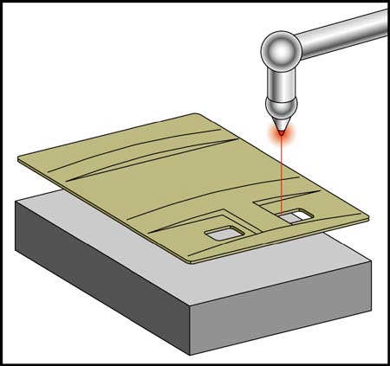
Product Trimming – Methods
Azdel sheets are normally supplied cut to size, however, it is possible to cut the sheets to a different size utilizing a mechanical shear. The sheet can also cut easily with a utility knife.
Part trimming can be accomplished using several different options:
• In-mold bypass-punch die (double acting press/mold)
• Secondary bypass-punch die
• Steel-rule die
• Laser trimming
• Water-jet trimming
• NC Router

Slide 40
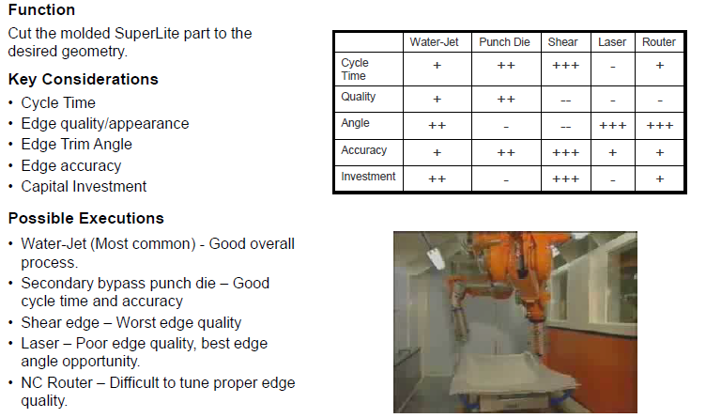
Product Trimming – Methods (cont.)

Slide 41
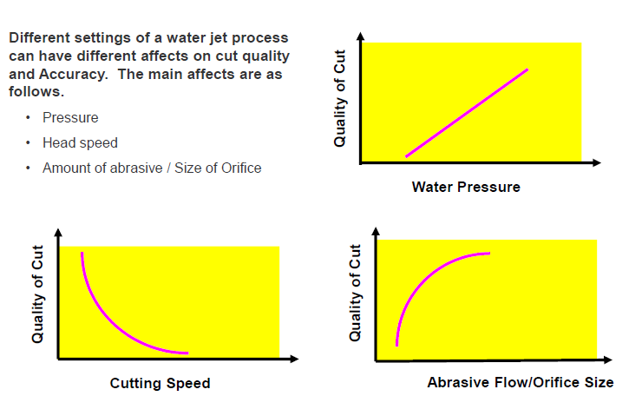
Water-Jet Factors

Slide 42
Dimensional Stability
The Coefficient of Linear Thermal Expansion (CLTE) of SuperLite family products is comparable to aluminum and thermo setting plastics.
Typical CLTE values @ 55% glass and 2.5mm molded thickness are:
800 GSM: 13.5x10-6mm/mm/°C
2000 GSM:18.9x10-6mm/mm/°C
Heat shrinkage
4.00
Typical shrinkage values @ 55% glass and 2.5mm molded thickness are:
3.00
×10 mm/mm
-3
2.00
Machine direction: 0.11 x10-3 mm/mm (0.011%)
Transverse direction: 0.17 x10-3 mm/mm (0.017%)
Average shrinkage: 0.14 x10-3 mm/mm (0.014%)
1.00
0.00
SuperLite
Urethane foam
Corrugated board
Resin
impregnated felt
MD
TD
In most cases, SuperLite tooling is cut with zero shrinkage allowances.

Slide 43

Edge Folding

Slide 44

Edge Folding (cont.)

Slide 45
Troubleshooting Section

Slide 46
Preliminary Troubleshooting
Before proceeding to the action steps, please check the items that follow below.
Pre-checks
Verify all the equipment, tooling, process, set-up and material has not been changed or modified since the last production run.
Request verification that the material meets specifications for the following:
  GSM
  Glass %
  Loft
  Density
  Sheet dimensions
  Film/scrim combination
Inspect the material for contamination (oil, water, etc.) that could have occurred during shipment or storage.
Determine the press is functioning properly:
  Close position
  Closing tonnage
Continue on next page

Slide 47
Preliminary Troubleshooting
Pre-checks (cont.)
Verify that the oven does not have any physical faults:
  Broken heating elements
  Blown fuses
  Severed wiring, loose thermocouples, or other disconnections
  Hot spots (runaway elements)
Verify proper heat distribution in the oven and mold. Can be done by
  Handheld IR thermometer*
  IR thermal imaging line scanner (oven – recommended)
  Contact pyrometer (mold)
Verify that molding parameters are within engineering specifications:
  Proper molded thickness
  Sheet line position
  Sheet and fabric positions
*NOTE: IR pyrometers do not read reflective surfaces accurately and may require special calibration.

Slide 48
General Troubleshooting Guidelines
The recommended general approach for correcting problems follows below.
Monitor the frequency and location of the problem to determine if it is occurring in a repeating fashion.
Record the current oven and mold temperatures and press set-up; compare to nominal (standard) settings.
Verify the material temperature at forming is close to 380-390˚F (193-199˚C).
Implement an interim containment or temporary corrective action plan.
Determine the root cause and implement a permanent corrective action plan.
Record the new process set-up conditions.

Slide 49
Troubleshooting Suggestions
Wiper Blades
  Check the location of the wiper blades on the tool. For wrinkle reduction, wiper blades should be 90˚ offset to the direction of the wrinkle.
  Check adjustment. Increase the engagement to create more stretch or decrease if the material shows signs of tearing.
Part Thickness
  Verify the molded thickness matches the design/print specification.
  Mold to the upper specification for part thickness.
Fabric Grippers
  Time/program the fabric grippers such that they release the fabric just before contacting the top mold.
Fabric Specification
  Confirm the fabric being used has the proper elongation properties in both the “X” and “Y” dimensions. 30-40% elongation is recommended.
  Check for the possibility of increasing elongation through process adjustment or through the fabric manufacturer.
Continue on next page

Slide 50

Troubleshooting Suggestions (cont.)
Adjust Board Temperature
  Add 10-20˚F (6-11˚C) to the top and bottom ovens.
  NOTE: If corrugation is seen,
  remove heat from the bottom and add to the top (maintain total heat profile).
  If film discoloration is seen, do not add any more heat to the top.
Adjust Mold Temperature
  Suggested tool temperatures are 20-50˚C (68-122˚F) for both top and bottom tools (dependent on part geometry).
  Recommended maximum allowable temperature difference between top and bottom tool is ~10˚C unless specified otherwise by the tool manufacturer.
Continue on next page

Slide 51
Troubleshooting Suggestions (cont.)
Material Position In-Mold
  Position the tool close height/sheet line such that the heated material is pushed by the upper tool into the lower tool.
  Minimize or prevent the heated material resting in the lower mold before tool closure, which causes rapid heat loss.
  Ensure the heated sheet does not interfere with the tools during indexing.
  Please Note:
  These steps are guidelines intended to help reduce or eliminate deformation in the finished product. Unfortunately, there are no two processes that are exactly alike so there is no definite value that can be applied to each of these steps. In other words, there will always be some degree of trial-and-error.
  It’s possible that only one adjustment may be needed. It is equally possible that several adjustments will be needed. Use caution during the adjustment process: make only one adjustment at a time. This will allow a proper assessment of the outcome of each adjustment.

Slide 52
Specific Troubleshooting
Loft-related Considerations
  “Loft” is the common term used for the expansion in the z-direction (thickness) of the material during preheating. The final lofted target thickness, typically measured in mm, is dependent on grade and *basis weight of the material. SuperLite material will loft to a final thickness of 3.5-9 mm while ExtraLite material will loft to a final thickness in the 5-22 mm range. (ExtraLite material has an added lofting agent that enables it to loft to significantly higher thicknesses.)
  All grades and their associated loft values are influenced by both time (residence time in the oven[s]) and temperature (heating setpoints). Since no two processes are identical, it’s difficult to predict times and temperatures for a given product or line. Common settings are 55 seconds of oven soak time with a target oven-out temperature of 400-420˚F and a mold-close temperature of 380-390˚F.
*Basis weight is the weight per unit area and is measured in g/m² (GSM ).

Slide 53

Specific Troubleshooting (cont.)
Loft-related Considerations (cont.)
Both over-lofting and under-lofting can cause problems and can usually be traced back to improper heating. If loft is considered a potential issue, conduct a “free-loft”: run a board through the heating process, stop the forming process as soon as the board is fully indexed out of the oven, and allow the lofted board to cool in the rails for about 2 minutes.
Remove the lofted board and cut samples for measurement. Each sample will typically have a range of values but should still fall within the specified range for that material. If there’s a localized problem, check that specific area for loft. Also, it’s beneficial to run a second board that has been rotated 180˚ to see if the problem “follows” the board.

Slide 54

Specific Troubleshooting (cont.)
Wrinkles
Conduct a free loft of the board to verify the material is lofting correctly and there is no excessive shrinkage of the board.
If the problem is recurring in the same location, rotate the board 180˚ and form. If the wrinkle does not change position, the problem is process-related.
Verify the clamps on the front and rear of tool are grabbing the material through mold close.
If wiper blades are in use, adjust them for increased engagement. One method is to adjust the blades until too much fabric tension occurs, then back off until that extra tension disappears. If fabric tension is not an issue, lower the wiper blades to the lowest position. If the lowest position is not sufficient, longer blades or increased travel of the existing blades may be required.
Platen position can affect wrinkles. With dual moving platens, it may be necessary to mold below the sheetline. Lower both platens below sheet line in increments of 1 inch (25mm) and look for any changes to wrinkles after each adjustment.

Slide 55
Specific Troubleshooting (cont.)
Wrinkles (cont.)
Verify proper board temperature at oven exit (400-420˚F/204-216˚C) and mold close (380-390˚F/193-199˚C).
Low mold temperature can contribute to wrinkles and/or tearing. Mold temperatures are commonly set at 80˚F/27˚C, but can range as high as 140˚F 60˚C in some cases.
If the sheet is exhibiting ripples when exiting oven, the board temperature is likely too hot; reduce the lower heater setpoints. The bottom-of-board temperature can go as low as 330-350˚F (166-177˚C) as long as proper loft and top-of-board temperatures are maintained (370-400˚F/188-204˚C). If the process allows zone adjustment, lowering the setpoints to the center zones only is recommended while raising the heat to the outer edges of top and bottom ovens to preserve the overall heat profile.
Molded thickness: some geometries (outside/inside radii) may require molded thickness of 1mm. This is the thickness of the board with the fabric and foam removed so only measure the Azdel after molding. If buildup is required, the use of aluminum Teflon tape is common.

Slide 56

Specific Troubleshooting (cont.)
Scrim tearing
Check the tool for any burrs or obstructions which could snag the scrim.
Free loft a board and look for any scratches or tearing of the scrim side of board. If scratches or tearing are evident, look at the upstream equipment (support wires, conveying system, etc.) to identify the source.
Verify the correct scrim was selected (sourced) that will accommodate the depth of draw of the tool.
Verify optimal molding temperature. Typical core temperature for board at oven exit is 400-420˚F and at mold close is 380-390˚F. These temperatures will vary on a case-by-case basis as no two processes are identical.
Inspect the raw board for tears, scratches, folds, or other abnormalities that can cause tearing.
Check for excessive heating or sag. A “hot spot” in a lower oven can cause a localized scrim burn while excessive sag can cause a tear when dragged across a hot sag band.

Slide 57

Specific Troubleshooting (cont.)
Scrim delamination
Check for overheating and reduce the heat on bottom oven until the scrim stays attached. At the same time, add heat to the top oven to maintain a consistent overall heat profile. Use caution when adding heat to the top; it may not be necessary to replace the full amount taken from the bottom.
Excessive residence time (“soak” time) can contribute to this condition. Reduce the amount of time the material is in the oven until the scrim stays attached to the core. Once the scrim stays attached, begin raising the bottom and top oven temperature setpoints. Verify the desired board temperature is being reached by using heat tape, an IR pyrometer, *MOLE unit, or built-in IR line scanner**.
Check to board as it exits the oven to verify the scrim surface is not hitting or dragging on the tool, oven, or some other piece of process equipment.
NOTES
* A MOLE unit is a specialized test device for measuring real-time core temperature.
**IR line scanners are highly effective in balancing and maintaining a consistent and reliable oven heating profile. We strongly recommend their use.

Slide 58

Specific Troubleshooting (cont.)
Fabric Delamination
Verify desired film temperature at mold close: 380-390˚F (193-199˚C), although this will vary from process to process. Temperatures may need to be increased or decreased depending on transfer time from oven exit to mold close. Transfer times of 10-15 seconds are best.
Test the film on a raw board with a Dyne pen to verify the film was applied to the board correctly. If the ink beads up into droplets, it is incorrectly applied.
Verify oven setpoints match the actual temperatures. Fabric delamination can occur from the film being too hot or too cold. An oven heater that is either not functioning or overheating can cause such a condition. Again, a built-in IR line scanner can instantly pinpoint these failures, but they can also be found via heat tape, IR pyrometer, or a MOLE unit.
Check the mold-open motion to confirm the tooling is not pulling the fabric.

Slide 59
Specific Troubleshooting (cont.)
Fabric Delamination (cont.)
Validate the fabric construction by checking with the fabric manufacturer. Items to research are recent changes in foam, adhesive, elongation, and suppliers of their raw materials. If possible, perform tests to confirm the fabric meets original specifications. If the foam has changed and has a lesser ILD force this will impact the adhesion.
If the oven has an exhaust, verify there are no obstructions to air flow.
Verify the adhesive being used is the correct GSM.
Check the molded thickness to confirm the proper compression is being achieved. Removal of tool shims (usually in 0.25 mm increments) may be necessary to generate proper compression.
Too much fabric tension is another cause for delamination. Reducing the fabric tension in the location(s) of the separation should alleviate this condition. If tension reduction is not possible or not enough, tape the area(s) of concern to create more compression.

Slide 60

Specific Troubleshooting (cont.)
Warp or Deformation
Too much tension on the fabric can cause warping of the product. Reduce tension by lowering the applied tension being created by the tensioning device being used. If tension is being induced by the tool closing, release the fabric from the clamps slightly sooner during closure.
Material temperature can cause warp. Make sure material is reaching the optimal temperatures at mold-close 380-390˚F (193-199˚C).
Proper cooling during formation is important. If cooling is insufficient, increase the closed-tool form time and/or decrease the tool temperature. Also, verify the mold is getting proper circulation (could have closed valves, clogged water filters, etc.) and the set points match the actual tool temperatures.
Review the specified elongation values of the fabric and compare them to the present lot of material. Reduced elongation could be causing “pull back” when released by the form tool.

